Slide 1
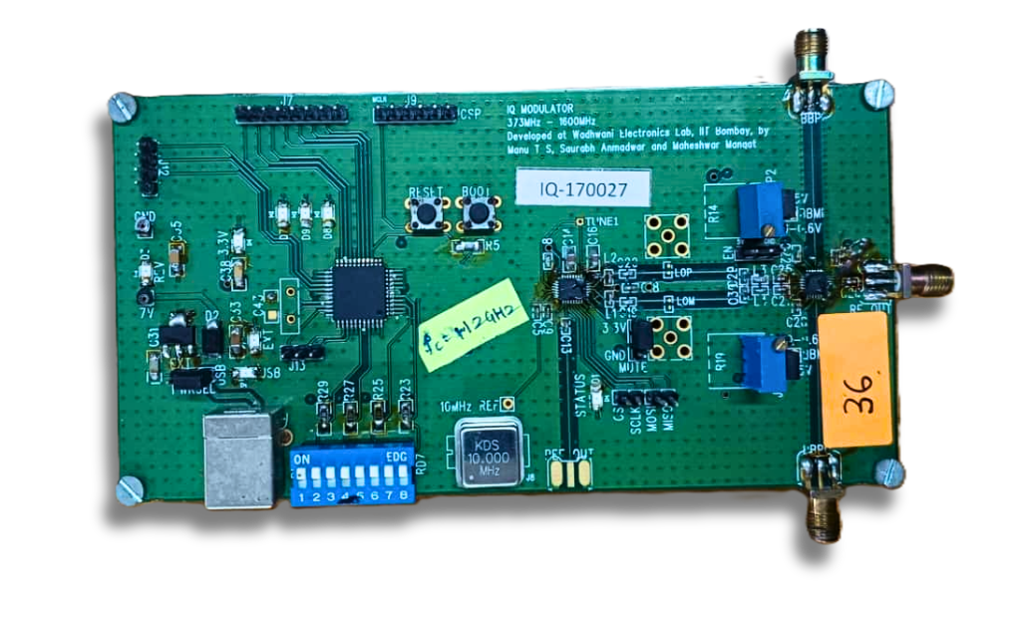
EE 340 Communications Lab
What's inside an
IQ Modulator Board

Slide 2
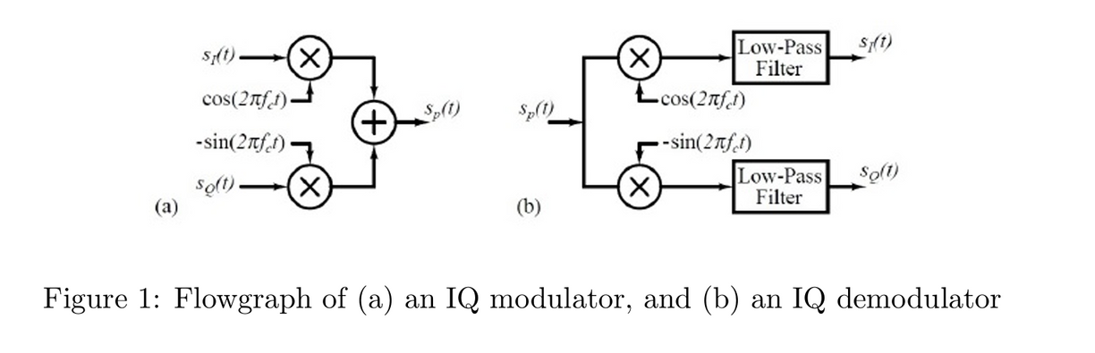
IQ Modulation implementation
sp(t)=sI(t)cos⁡(2πfct)−sQ(t)sin⁡(2πfct)

Slide 3
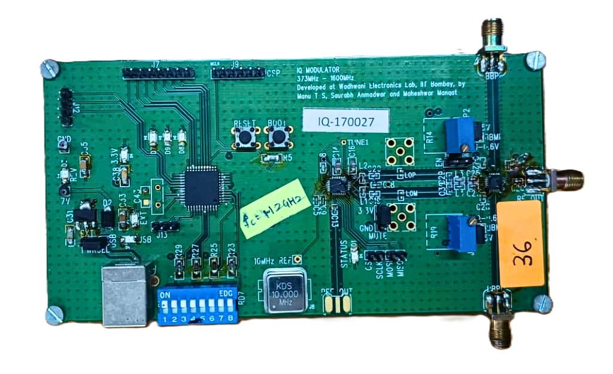
IQ Modulation implementation
sp(t)=sI(t)cos⁡(2πfct)−sQ(t)sin⁡(2πfct)

Slide 4
IQ Modulator Board

Slide 5
Ref. Frequency
USB Power
DIP Switches
(LSB-->--MSB)
Notes:
Provides power and for programming
icsp - Allows firmware updates or reprogramming of the microcontroller directly on the board without removing it.

Slide 6
RESET Button
PLL (SPI Slave)
Microcontroller
PIC18F4550
(SPI Master)
Ref. Frequency
USB Power
DIP Switches
(LSB-->--MSB)

Slide 7
I-Channel Input
RESET Button
PLL (SPI Slave)
Modulator IC
Microcontroller
PIC18F4550
(SPI Master)
Out to Antenna
Ref. Frequency
USB Power
DIP Switches
(LSB-->--MSB)
Q-Channel Input

Slide 8
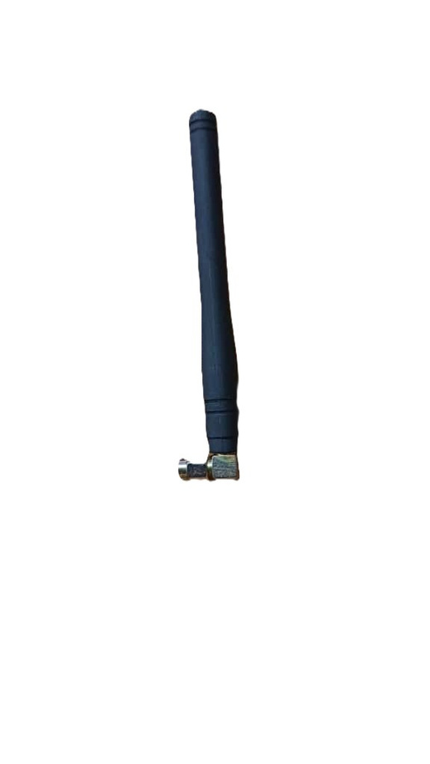
I-Channel Input
RESET Button
PLL (SPI Slave)
Modulator IC
Microcontroller
PIC18F4550
(SPI Master)
Out to Antenna
Ref. Frequency
USB Power
DIP Switches
(LSB-->--MSB)
Q-Channel Input

Slide 9
Block Diagram
ICSP
s (t) + V
i
dc,bias,i
8 bit DIP Switch
Microcontroller
PIC18F4550
Freq. Synthesizer
(PLL) LTC6946-1
cos⁡(2πf t)
IQ Modulator
LTC5598
c
s (t)
p
USB
10 MHz REFERENCE INPUT
s (t) + V
q
dc,bias,q

Slide 10
LSB is the switch closest to the USB connector
ICSP
s (t) + V
i
dc,bias,i
8 bit DIP Switch
Microcontroller
PIC18F4550
Freq. Synthesizer
(PLL) LTC6946-1
cos⁡(2πf t)
IQ Modulator
LTC5598
c
s (t)
p
USB
10 MHz REFERENCE INPUT
s (t) + V
q
dc,bias,q
Notes:
Sets the PLL register bits to select the carrier frequency
𝑓𝑐. Each group uses a unique DIP setting to avoid frequency overlap.

Slide 11
Connect to USB port of AFG
ICSP
s (t) + V
i
dc,bias,i
8 bit DIP Switch
Microcontroller
PIC18F4550
Freq. Synthesizer
(PLL) LTC6946-1
cos⁡(2πf t)
IQ Modulator
LTC5598
c
s (t)
p
USB
10 MHz REFERENCE INPUT
s (t) + V
q
dc,bias,q
Notes:
Configures the PLL via SPI. It programs 96 bits across 12 registers to set loop bandwidth, division ratio, and lock behavior.

Slide 12

Check for the RED STATUS LED
ICSP
s (t) + V
i
dc,bias,i
8 bit DIP Switch
Microcontroller
PIC18F4550
Freq. Synthesizer
(PLL) LTC6946-1
cos⁡(2πf t)
IQ Modulator
LTC5598
c
s (t)
p
USB
10 MHz REFERENCE INPUT
s (t) + V
q
dc,bias,q
Notes:
Generates the carrier signal
cos(2𝜋𝑓𝑐𝑡) from a 10 MHz reference input. The output frequency is 𝑓out =𝑁⋅𝑓ref.

Slide 13
V DC,Bias (~0.45 V) as too high (>0.58 V) risks damaging the modulator
ICSP
s (t) + V
i
dc,bias,i
8 bit DIP Switch
Microcontroller
PIC18F4550
Freq. Synthesizer
(PLL) LTC6946-1
cos⁡(2πf t)
IQ Modulator
LTC5598
c
s (t)
p
USB
10 MHz REFERENCE INPUT
s (t) + V
q
dc,bias,q
Notes:
Takes in the I and Q baseband signals (with DC bias) and the carrier signal. Internally generates 0° and 90° carrier phases, multiplies them with 𝑠𝐼(𝑡) and 𝑠𝑄(𝑡), and combines them to produce 𝑠𝑝(𝑡).

Slide 14
DIP Switch
8 bit DIP Switch
Microcontroller
PIC18F4550
Let’s say Table no. 3 is setting up
ON
EDG
DIP value= 2 × Table No.=2×3=6
Binary: 00000110
1
2
3
4
5
6
7
8
On this board, the base frequency is 1.12GHz & the minimum frequency increment has been designed as 1.25 MHz.
fc=1120.002 MHz+(1.25 MHz)×6=1127.502 MHz
Always RESET the board after setting DIP switches.

Slide 15
Thank you
Reach out to us, for any doubts

